Slide 1
Asylum & FGM
Dr Charlotte Proudman
Barrister and Junior Research Fellow at Queens’ College, Cambridge
Dr Peter W. Walsh
Researcher, The Migration Observatory,
University of Oxford

Slide 2
Asylum in the UK An Overview
Peter William Walsh

Slide 3
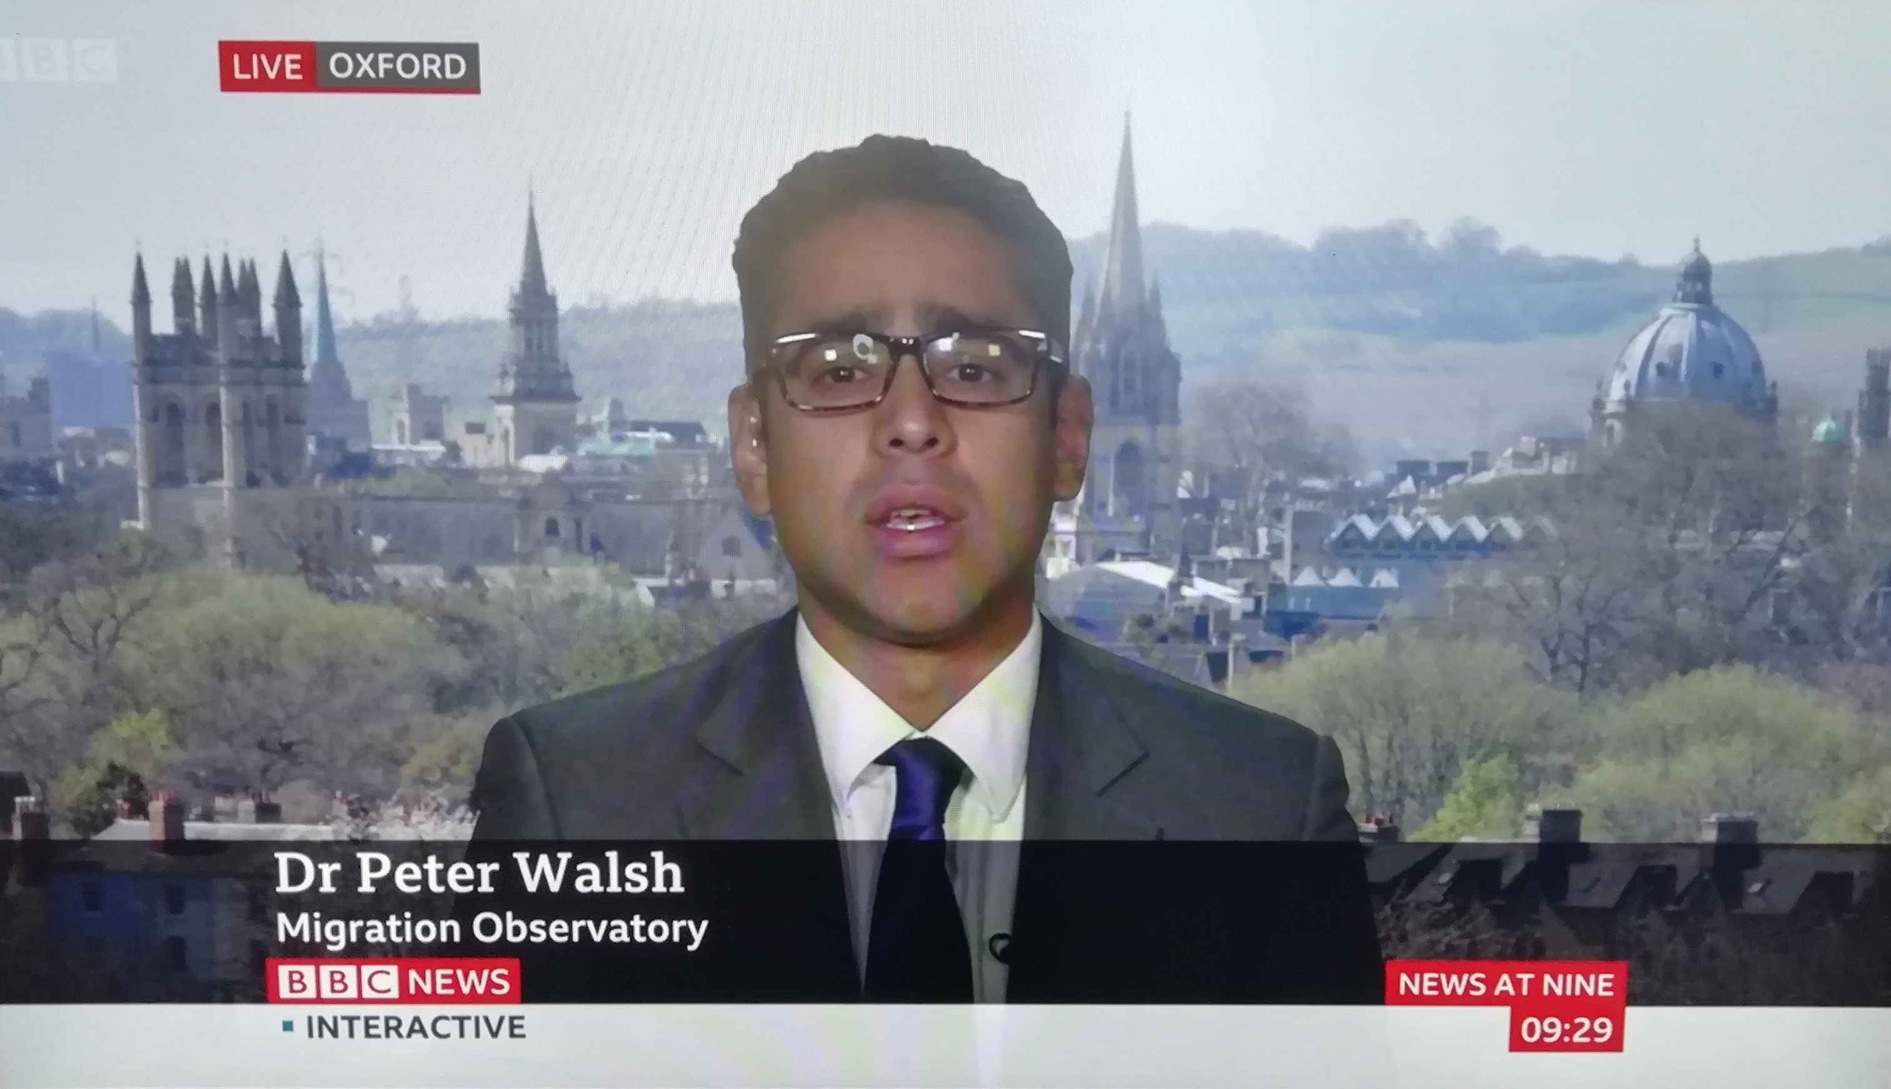

Slide 5
How long have people who came to the UK to seek asylum lived in the country for (as at 2018)?

Slide 6
Number of asylum seekers to the UK per year, 1979 to 2018

Slide 7
Number of grants of protection per year, at initial decision, 1979 to 2018

Slide 9
How do appeals against initial asylum decisions affect overall grant rates?

Slide 10
How do appeals against initial asylum decisions affect overall grant rates?
13%
19%
Notes:
This suggests that the quality of asylum decision making has been getting worse. Almost 40% of refusals are determined by an immigration judge to be wrong.
But not only is decision-making poor, it’s also slow.

Slide 11
Share of asylum applications concluded within 12 months and 36 months, UK, 2010/11 to 2018/19
Notes:
All these data come from a relatively underutilised dataset.

Slide 12
Share of asylum applications receiving an initial decision within six months

Slide 13
Share of asylum applications receiving an initial decision within six months

Slide 14
“We are committed to ensuring that asylum claims are considered without unnecessary delay, to ensure that individuals who need protection are granted asylum as soon as possible and can start to integrate and rebuild their lives, including those granted at appeal.”

Slide 15
“Whilst we take steps to increase capacity and focus on process improvements to deliver better quality decisions more efficiently, we have moved away from the 6-month service standard…”

Slide 16
“In one recent case, there were gaps and inconsistencies in an application and it would have been very easy to refuse it. The harder part is to dig around online and properly research why those inconsistencies are there. But that effort would eat into my stats and I would then get a black mark against my performance.”
Home Office asylum decision-maker

Slide 17
Distribution of asylum seekers and resettled refugees across the UK as share of regional population (as at June 2019)

Slide 18
Number of asylum seekers resident in the UK’s local authorities (absolute numbers as at June 2019)
Notes:
20 local authorities hosting the same number of asylum seekers as the remaining 362 combined.

Slide 19
Asylum applications by region of main applicants’ nationality

Slide 20
Asylum grants at initial decision by region of nationality

Slide 21
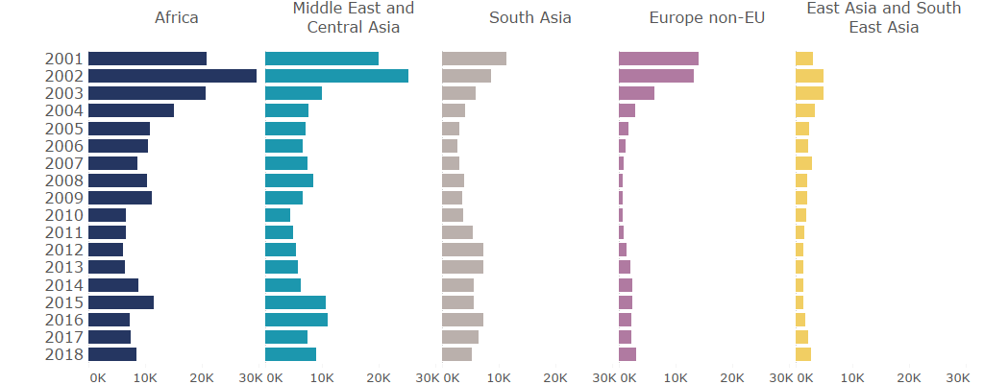
Asylum applications by region of main applicant’s nationality

Slide 22
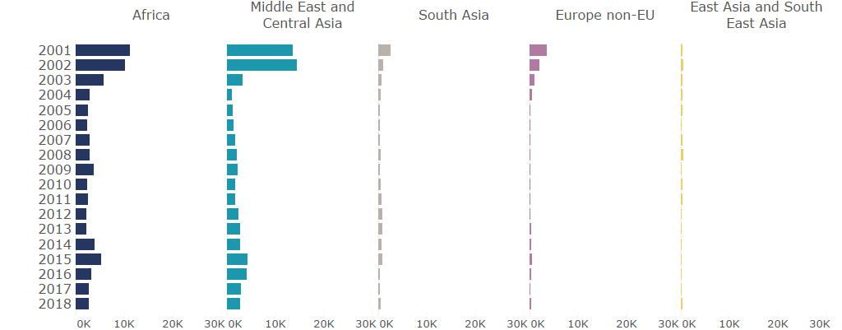
Asylum grants at initial decision by region of nationality

Slide 23
Top ten nationalities of asylum seekers to the UK, 2018
Rank | Country of nationality | Number of main applicants | Share of all applicants in 2018 | Share ultimately granted protection, 2012-2016¹
1 | Iran | 3,320 | 11% | 70%
2 | Iraq | 2,700 | 9% | 43%
3 | Eritrea | 2,151 | 7% | 88%
4 | Pakistan | 2,033 | 7% | 33%
5 | Albania | 2,005 | 7% | 42%
6 | Sudan | 1,611 | 5% | 89%
7 | Afghanistan | 1,349 | 5% | 59%
8 | India | 1,321 | 4% | 5%
9 | Bangladesh | 1,297 | 4% | 18%
10 | Vietnam | 1,215 | 4% | 48%
Notes:
Main applicants, excluding dependants

Slide 24
Estimated asylum seekers per 1,000 population for the EU-28, Iceland, Liechtenstein, Norway and Switzerland, 2018

Slide 25
How long have people who came to the UK to seek asylum lived here for?
Number of people seeking asylum in the UK from 1979 to 2018
Asylum application grant rates
Appeal success rates (quality of initial decision-making)
Asylum claim waiting times (share receiving an initial decision within the 6-month service standard)
Geographical distribution of asylum seekers and resettled refugees
Nationality breakdown of asylum seekers
How many asylum seekers does the UK receive in comparison with the rest of the EU?
Notes:
Of contemporary interest
Novel – not widely known (fairly exotic topic)
Speak to inequality, injustice, or failure (here government failure

Slide 26
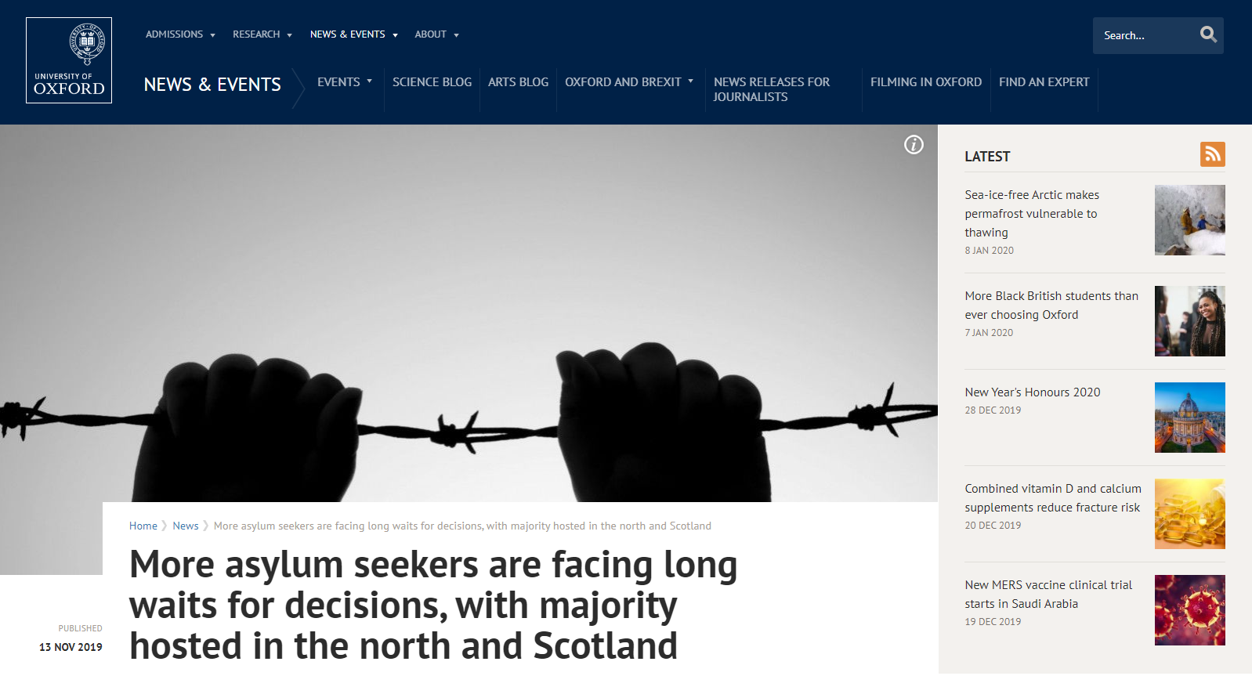

Slide 27
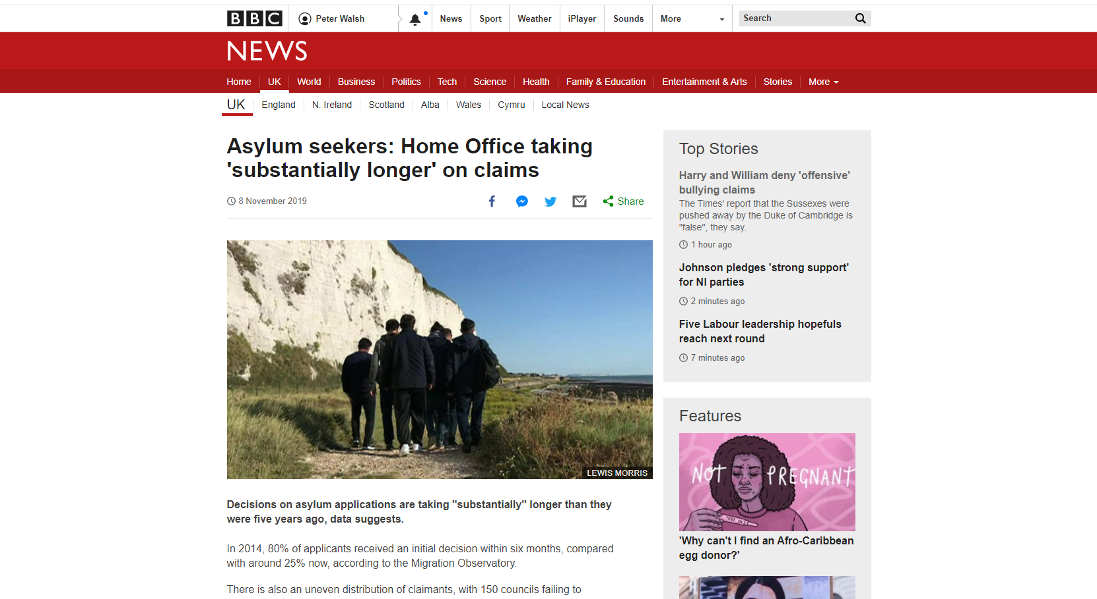

Slide 28
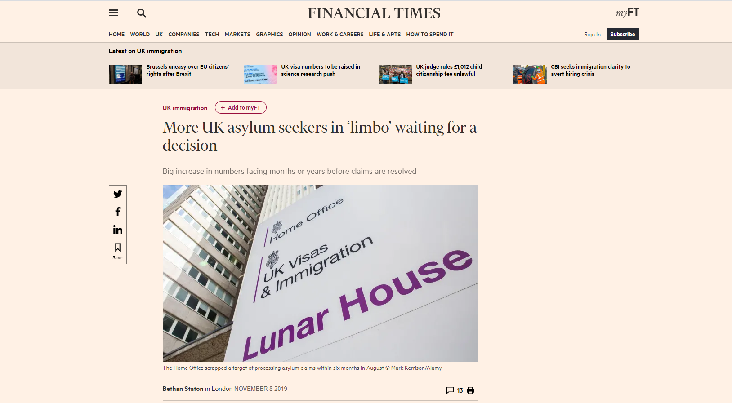

Slide 29
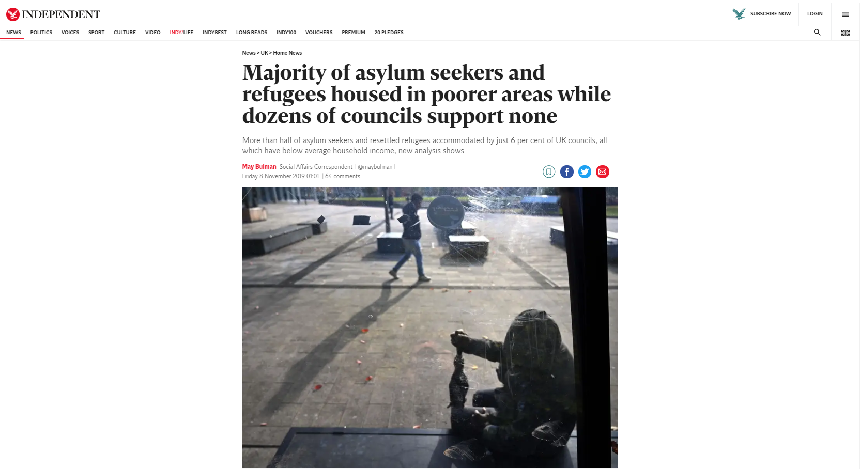

Slide 31
Outline of the presentation
FGM Statistics
Asylum claims and FGM
FGM Protection Orders under Schedule 2, FGM Act 2003
Jurisprudence
Overlap – asylum claims and FGMPOs
Conclusion: Gaps/lacunas in existing legislative framework of FGMPOs

Slide 32
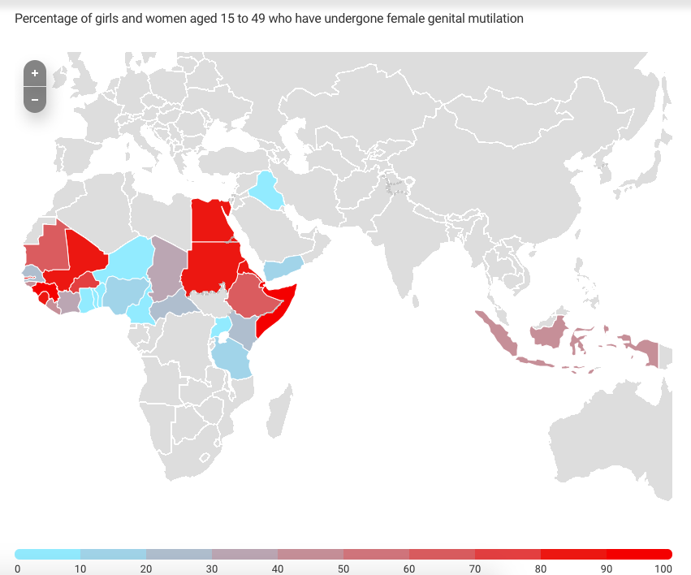
FGM Statistics
At least 200 million girls and women have been cut in 31 countries with representative data on prevalence (UNICEF, WHO, 2019).
The practice is almost universal in Somalia, Guinea and Djibouti, with levels around 90 per cent, while it affects no more than 1 per cent of adolescent girls in Cameroon, the Maldives and Uganda (UNICEF, 2019).
In England and Wales, it is believed that c.103,000 women and girls are living with FGM (City University, 2015).
Between April 2015 and September 2019, a total of 45,950 attendances to health services occurred in England by individuals who have been identified to have suffered FGM, or where the attendance to services was due to a consequence of suffering FGM (NHS data set, 2019).

Slide 33
Asylum claims and FGM
Statistics There are no statistics on the numbers of FGM asylum claims each year in the UK (or the EU). Of the 25,000 girls and women seeking asylum in Europe in 2014, 71% had already been subject to FGM (UNHCR). In 2011, 2,410 women claiming asylum in the UK were from FGM-risk countries, that equates to 27.40% of female asylum claims. The numbers continue to increase each year.

Slide 34
Asylum claims and FGM
The 1951 Refugee Convention (Art 1 A(2)) states that a refugee is a “person who has a well-founded fear of persecution for reasons of race, religion, nationality, membership of a particular social group or political opinion, owing to such fear, is unwilling to avail himself of the protection of that country”.
In the leading case of Fornah (FC) (Appellant) v. SSHD (Respondent) [2006] UKHL 46, the House of Lords held that FGM constitutes treatment violating Article 3 of European Convention on Human Rights (torture, cruel, inhuman or degrading treatment) and persecution within the Refugee Convention.

Slide 35
Asylum claim refusals
Common arguments: 1. High standard of proof – seek supporting evidence, how can one prove that a child will be cut?
2. Credibility – delay in claiming asylum (Ameh v UK) (Decision) App no 4539/11 (ECtHR, 2011); lack of knowledge about FGM community and prevalence rates; not describing the trauma in detail or being inconsistent; not reporting FGM to the police; conflict between claimant’s account and country policy; family protection. 3. Internal relocation in country as a single woman and lone parent & NGO support. 4. State protection – e.g. FGM is a criminal offence in Nigeria.

Slide 36
FGM Protection Orders Schedule 2, FGM Act 2003
Power to make FGM protection order
1(1)The court in England and Wales may make an order (an “FGM protection order”) for the purposes of—
(a)protecting a girl against the commission of a genital mutilation offence, or
(b)protecting a girl against whom any such offence has been committed.
(2)In deciding whether to exercise its powers under this paragraph and, if so, in what manner, the court must have regard to all the circumstances, including the need to secure the health, safety and well-being of the girl to be protected.
(3)An FGM protection order may contain—
(a)such prohibitions, restrictions or requirements, and
(b)such other terms,
as the court considers appropriate for the purposes of the order.
(4)The terms of an FGM protection order may, in particular, relate to—
(a)conduct outside England and Wales as well as (or instead of) conduct within England and Wales;
(b)respondents who are, or may become, involved in other respects as well as (or instead of) respondents who commit or attempt to commit, or may commit or attempt to commit, a genital mutilation offence against a girl;
(c)other persons who are, or may become, involved in other respects as well as respondents of any kind.

Slide 37
FGM Protection Orders
FGM was made a criminal offence in 1985 in England and Wales, Prohibition of Female Circumcision Act 1985 yet there has only been one criminal conviction for FGM despite the significant numbers of women and girls whom have undergone FGM. As a result, the government introduced FGMPOs under the Serious Crime Act 2015 to prevent FGM from taking place.
FGM Protection Orders modelled on Forced Marriage Protection Orders.
Purpose: preventative measure.
Injunctive remedy designed to encourage women/girls to seek legal protection through the courts.
Legal test: Consider all the circumstances including the health, safety, and well-being of the girl.
Breach of an order becomes indictable as a criminal offence, up to 5 years imprisonment, fine or both.
An order can be made to protect either a girl at risk of FGM or to protect a girl when FGM has been committed.
Order can include prohibitions/restrictions and other requirements to protect a girl. For example:
Removal of the passport of the protected person;
Protected person cannot leave the jurisdiction (port alert);
Medical examination;
Risk assessment ordered;
Prohibition of named respondent having contact with the protected person.
Order may relate to conduct outside England & Wales as well as within the country. However, the enforcement of an order relating to conduct outside of the jurisdiction obviously has a number of barriers.
Order for specified period of time or until varied or discharged.

Slide 38
FGMPOs Statistics
Family Court data from July 2015 to September 2019: a total of 408 applications for FGMPOs were made to the Family Court in England and Wales. From these applications 489 orders were made.

Slide 39
Jurisprudence – Case 1, Re X
Re X (Female Genital Mutilation Protection Order. No.2) [2019] EWHC 1990 (Fam)
No high-risk of FGM upon a British national child = travel ban on child.
The local authority applied for an FGMPO to protect a British child from FGM in Egypt. Her mother lived in England. Her father lived in Egypt.
The local authority sought a travel ban to prohibit the child from leaving the jurisdiction to visit her father in Egypt due to the risk of FGM.
After various expert reports, the court made a worldwide travel ban preventing the child from even visiting Scotland (by consent of the parents).
However, the court granted the mother leave to temporarily remove the child from the jurisdiction to Egypt to visit her father in 2019.
The case gives guidance on both the macro and the micro factors that must be taken into account when deciding a travel ban in a case where FGM is a risk.

Slide 40
Jurisprudence – Case 2, Re A
Re A (A Child: Female Genital Mutilation: Asylum [2019] EWHC 2475
A (A child) (Female Genital Mutilation Protection Order Application) [2020] EWHC 323 (Fam)
High-risk of FGM on non-British national according to Family Courts = removal from the UK
The case concerned a girl age 10 of Sudanese origin with Bahraini citizenship.
The mother applied for asylum on behalf of the girl, claiming a risk of FGM for the girl. The immigration application was refused by the Home Office and the immigration courts.
The family was served with removal directions.
The local authority (supported by the National FGM Centre) applied for a FGMPO due to concern that the girl would be cut if deported.
The court granted an injunction against the Home Secretary, prohibiting the removal of the girl.
The case was transferred to the President of the Family Division; the President decided that the family court does not have jurisdiction to make an injunction against the Home Secretary. The mother argued that FGM constitutes Article 3 ECHR and therefore the court ought to have power to restrain the Home Secretary from removing a child at risk of FGM from the jurisdiction.
The High Court concluded at a final hearing that the girl is at high risk of FGM but the Home Office seek removal.
Awaiting Court of Appeal decision about whether the immigration court’s decisions should bind the family court when assessing risk of FGM and deciding whether to make an FGMPO.
Also see, BA & Anor v JA & Ors (female genital mutilation protection orders and immigration appeals) [2018] EWHC 1754 (Fam) and HM v DM [2020] EWHC 1117 (Fam) The family court refused to grant FGMPOs where the child had insecure immigration status.

Slide 41
Home Office Guidance Gender issues in the asylum claim Version 3.0
“In cases where there is a protection order the detail of the individual protection order must be carefully considered, for example you may see cases which involve an FGM Protection Order (FGMPO) or Forced Marriage Protection Order. The fact that a protection order has been made by the Family Court may provide strong evidence of risk of persecution or serious harm. However, the order may not provide evidence about risk on return to their country, so does not in itself mean that refugee status should automatically be granted. The asylum claim must still be considered on its individual merits, taking into account that the Family Court has made an order and the reasons for it doing so. Such orders must be considered in the round and given appropriate weight in reaching your decision on future protection needs.
The fact that an order has been granted by the Family Court, which may state that the individual concerned should remain in the UK, does not mean that the person cannot be removed from the UK if after careful consideration the asylum claim is to be refused and you have concluded that the individual is not in need of international protection. GD (Ghana) highlights that whilst the Home Office is not bound by Family Court Orders they must be taken into consideration”.
10.04.2018, https://assets.publishing.service.gov.uk/government/uploads/system/uploads/attachment_data/file/699703/gender-issues-in-the-asylum-claim-v3.pdf

Slide 42
6 Gaps and lacunas under FGMPOs
Whilst FGMPOs can be made to protect people without secure British immigration status family courts are reluctant to make such orders, particularly when the risk is abroad, rather than in England and Wales (see: Re A (A Child: Female Genital Mutilation: Asylum [2019] EWHC 2475 and BA & Anor v JA & Ors (female genital mutilation protection orders and immigration appeals)[2018] EWHC 1754 (Fam)).
Family courts cannot prevent a girl without secure British immigration status from being deported (see case references above).
Local authorities are often reluctant to make applications for FGMPOs when a child does not have secure immigration British status.
If there is a low risk of FGM being performed abroad upon a child who has secure British immigration status, the family courts may impose a worldwide travel ban (see Re X (Female Genital Mutilation Protection Order. No.2) [2019] EWHC 1990 (Fam)).
We need an urgent review of asylum claims on the basis of FGM – how many are granted and refused? Are the women and children viewed by the Home Office as vulnerable?

